Slide 1
Open Questions & Architectural Ideas

Slide 2
Open Questions...

Slide 3
...what is the dispatcher?
...who builds it?

Slide 4
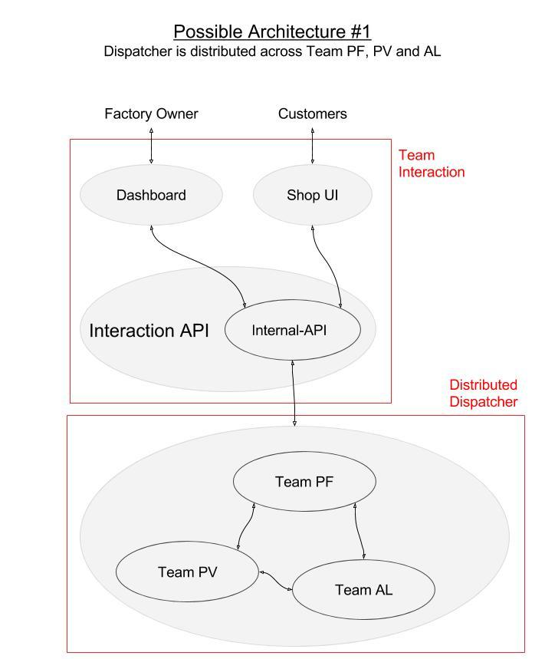
Distributed

Slide 5
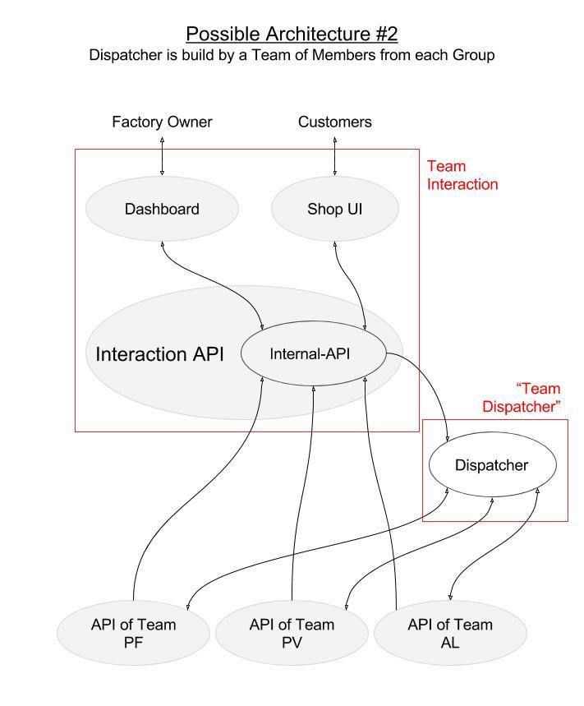
Hybrid

Slide 6
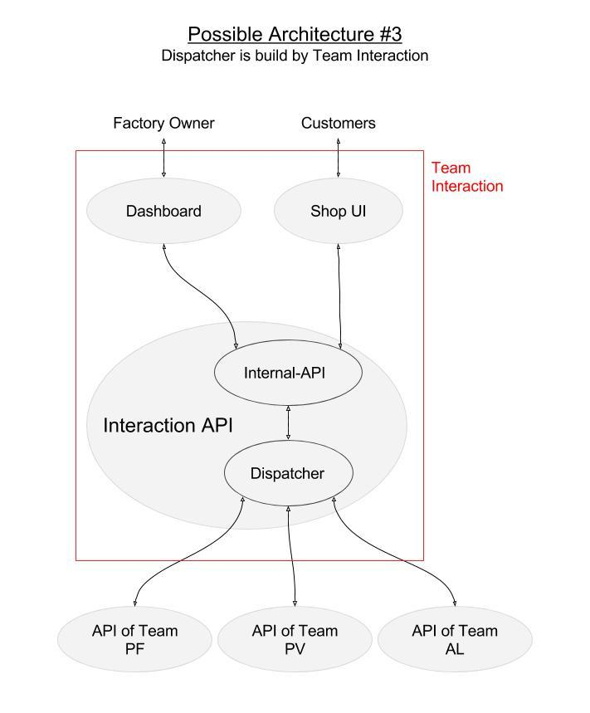
Centralized

Slide 7
How should we do it?

